Slide 1
Cityscapes Semantic Segmentation
for Self Driving Car
VisionX
Notes:
Tambah cover gambar (optional)

Slide 2

Team Members
Maruli Tyson Hamonangan Sianipar
Budi Kawira
Dana Putra Kembara
Efenus Valentino S
Mustafa

Slide 3
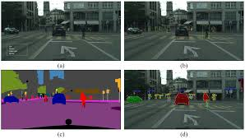
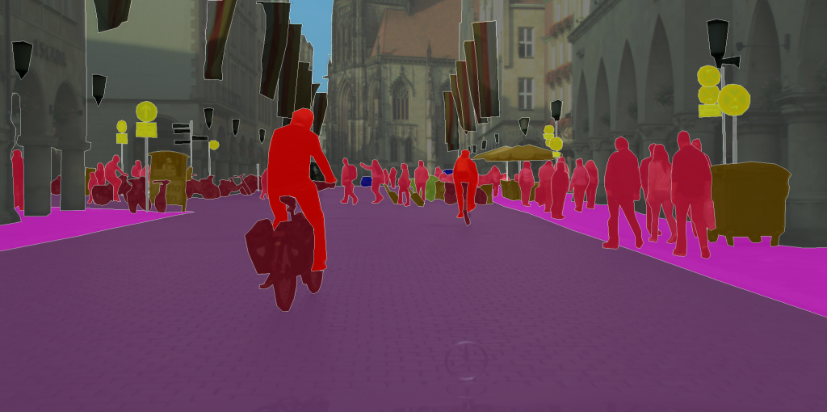
Background
Semantic segmentation is a crucial task in autonomous driving, enabling vehicles to understand and interpret their environment by classifying each pixel in an image into predefined categories such as road, pedestrian, vehicle, building, and more.
Cityscapes dataset provides high-quality, pixel-level annotations of urban street scenes, making it a standard benchmark for training and evaluating segmentation models for self-driving applications.

Slide 4
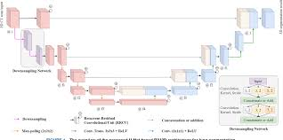
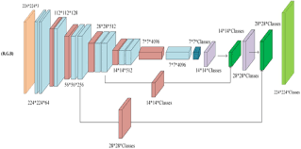
Project description
Project’s importance:
Semantic segmentation is crucial for self-driving cars because it provides a pixel-level understanding of the environment, which is essential for
Precise Obstacle Avoidance
Lane & Road Understanding
Traffic Sign/Signal Recognition
Contextual Awareness
Pedestrian Safety
Project’s goal:
Experiment with FCN8s and U-Net architectures to build a model for Cityscapes semantic segmentation. Understand the key parameters that influence prediction quality and be able to summarize the strengths and weaknesses of each architecture
U-Net
FCN8s

Slide 5
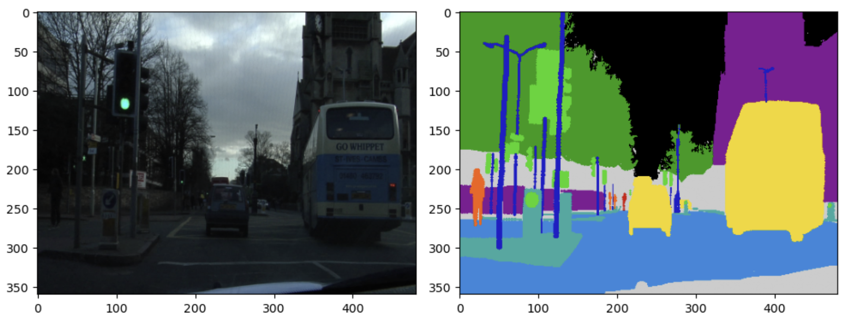

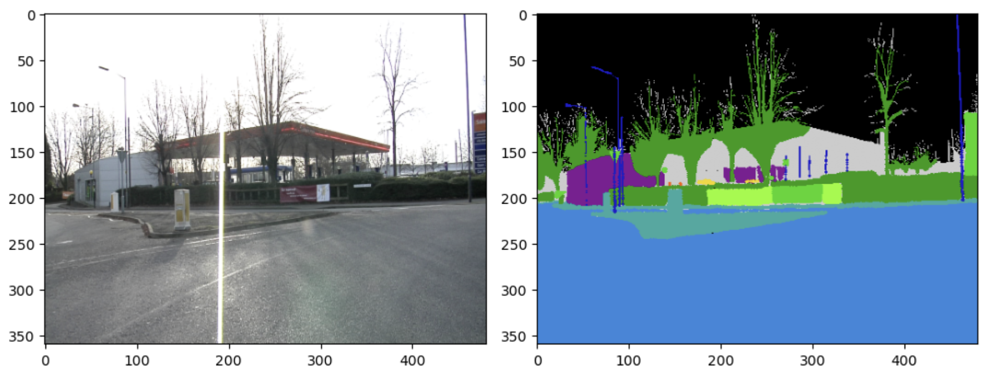
Dataset
Subset of Cityscape Dataset
www.cityscapes-dataset.com
Download Dataset Link
Object Segmentation Dataset
Image Mode : RGB
Mask Mode: L (Grayscale)

Slide 6
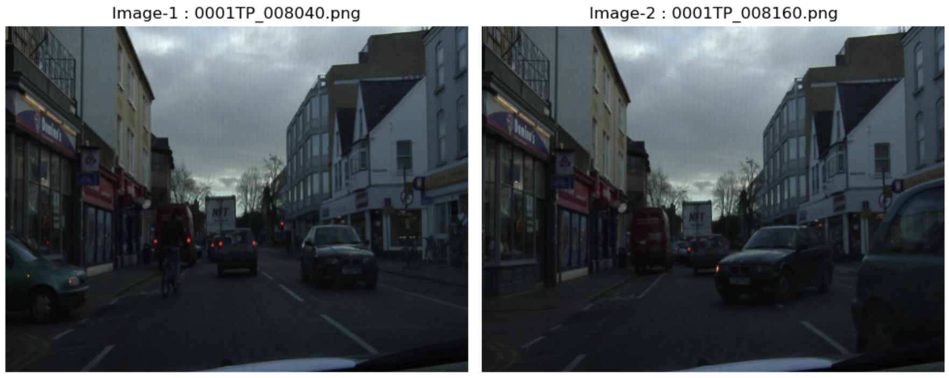
Dataset EDA
Validate Training Dataset
Some Hash Duplication
Count Image Files
vs Mask Files
Filter only File with pair of Image and Mask File
Check Image File Duplication with Hash Calculation
Not a real Duplication ?
Image: 398
Mask: 367
File: 367
Manual Check Image
Confirm no Duplication
Train File: 367
Double Check Image File Duplication with Feature Comparison (ORB Detector & BF Matcher)
Notes:
Tambah detail mengenai ukuran gambar (ex: rata2 size (common di-info-kan) atau scatter plot (width x height), picture type / extension), sample roboflow DS check feature

Slide 7
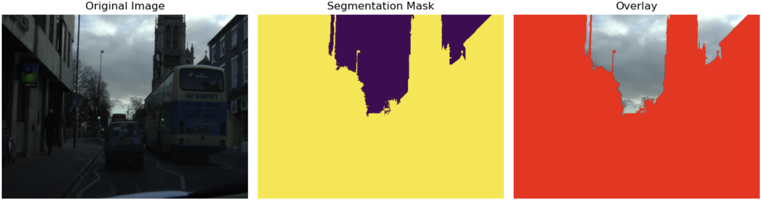
Dataset EDA
Based on training dataset, number of class is 12
Overlay the image with each class to have a visibility of the class name
Class 0 - Sky, exist in 366 files
RCNN

Slide 8
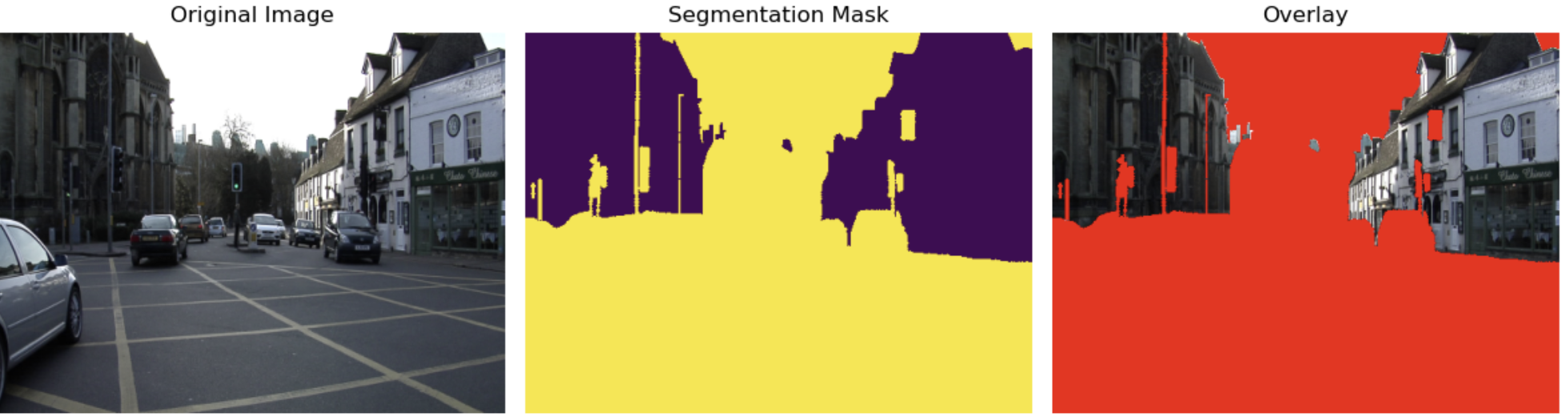
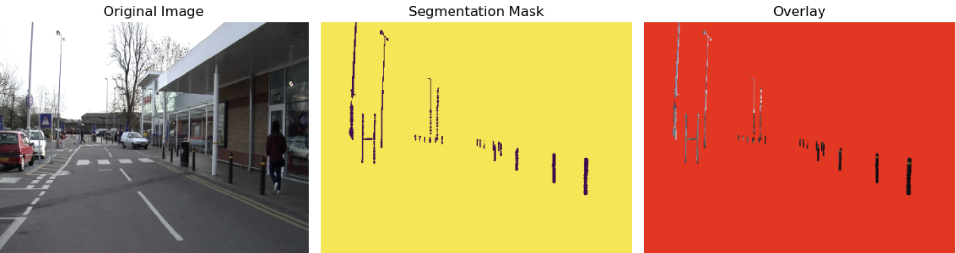
Dataset EDA
Class 1 - Building, exist in 365 files
Class 2 - Pole, exist in 366 files
RCNN

Slide 9
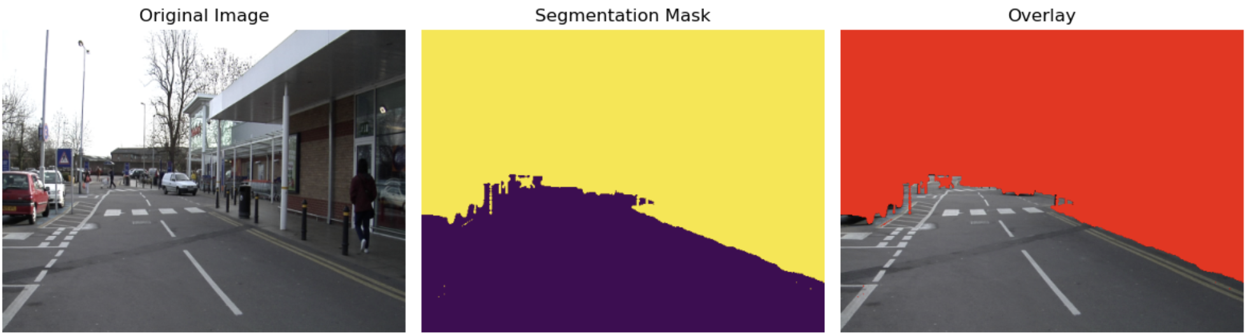
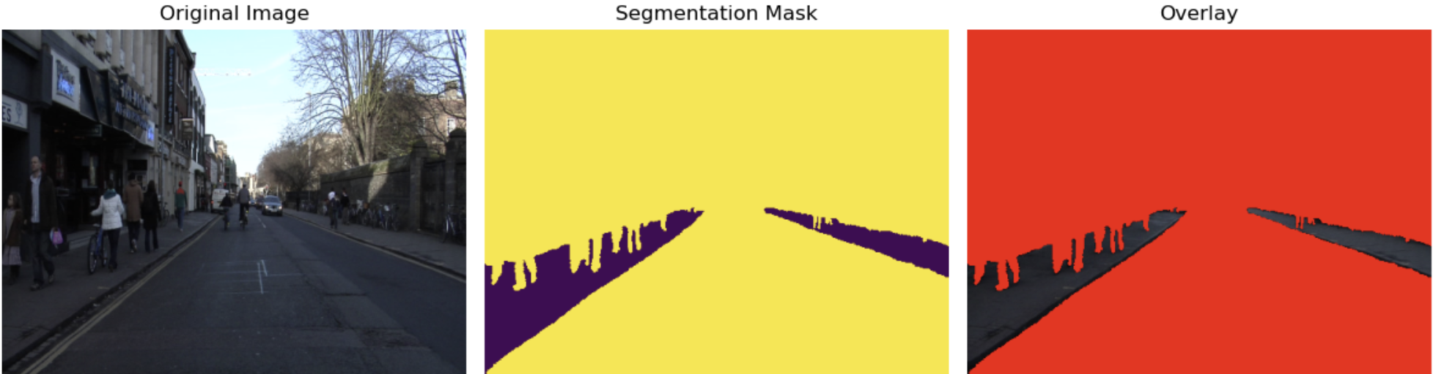
Dataset EDA
Class 3 - Road, exist in 367 files
Class 4 - Sidewalk, exist in 349 files
RCNN

Slide 10
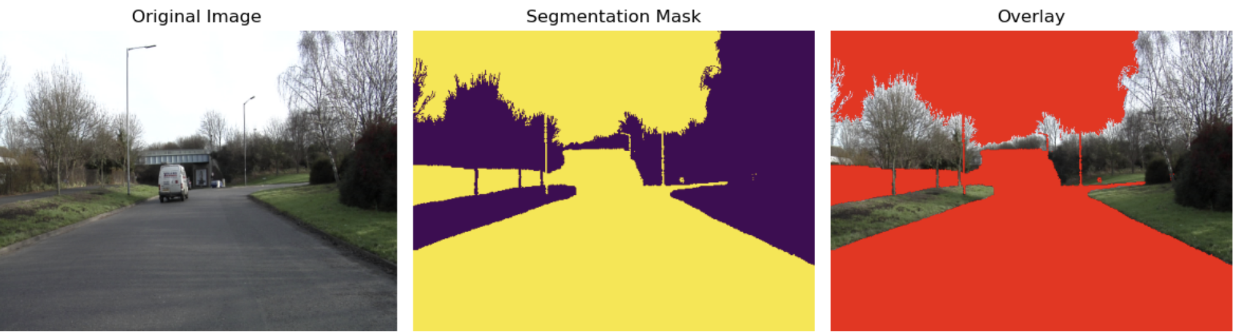
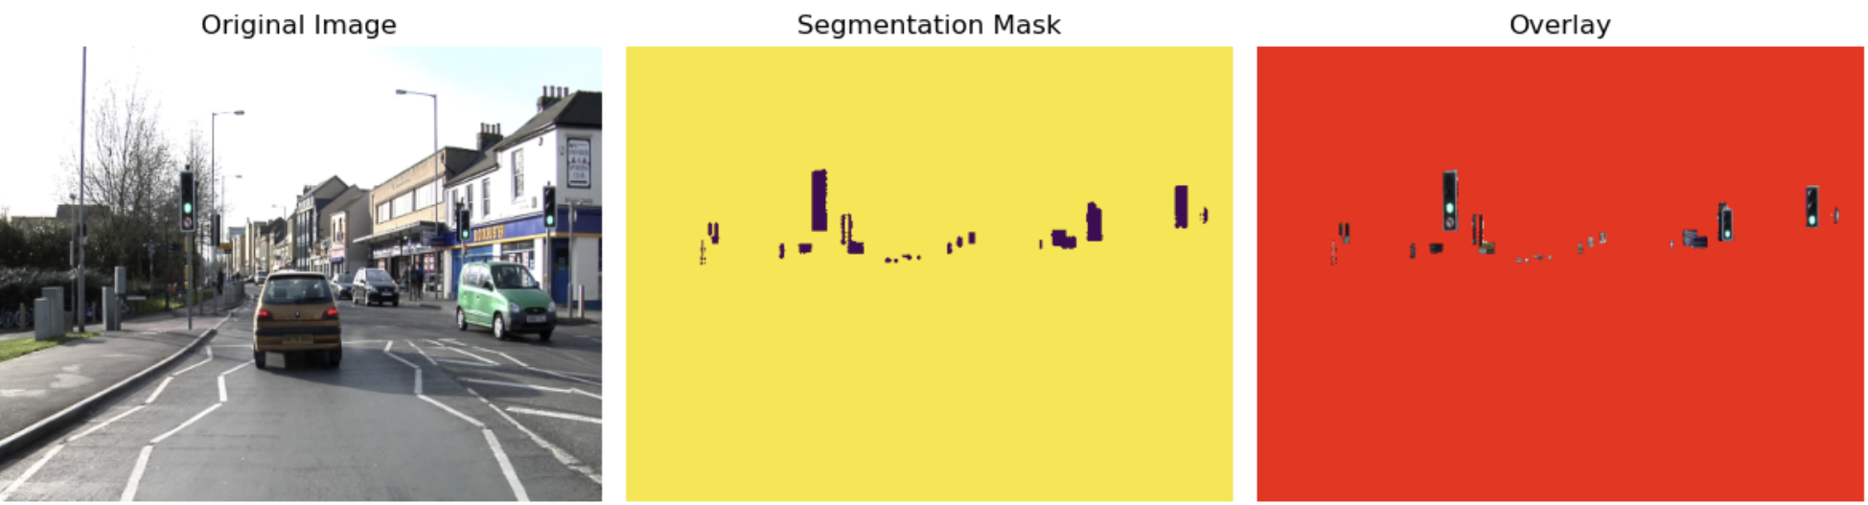
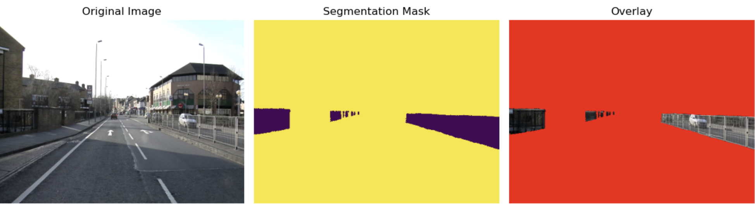
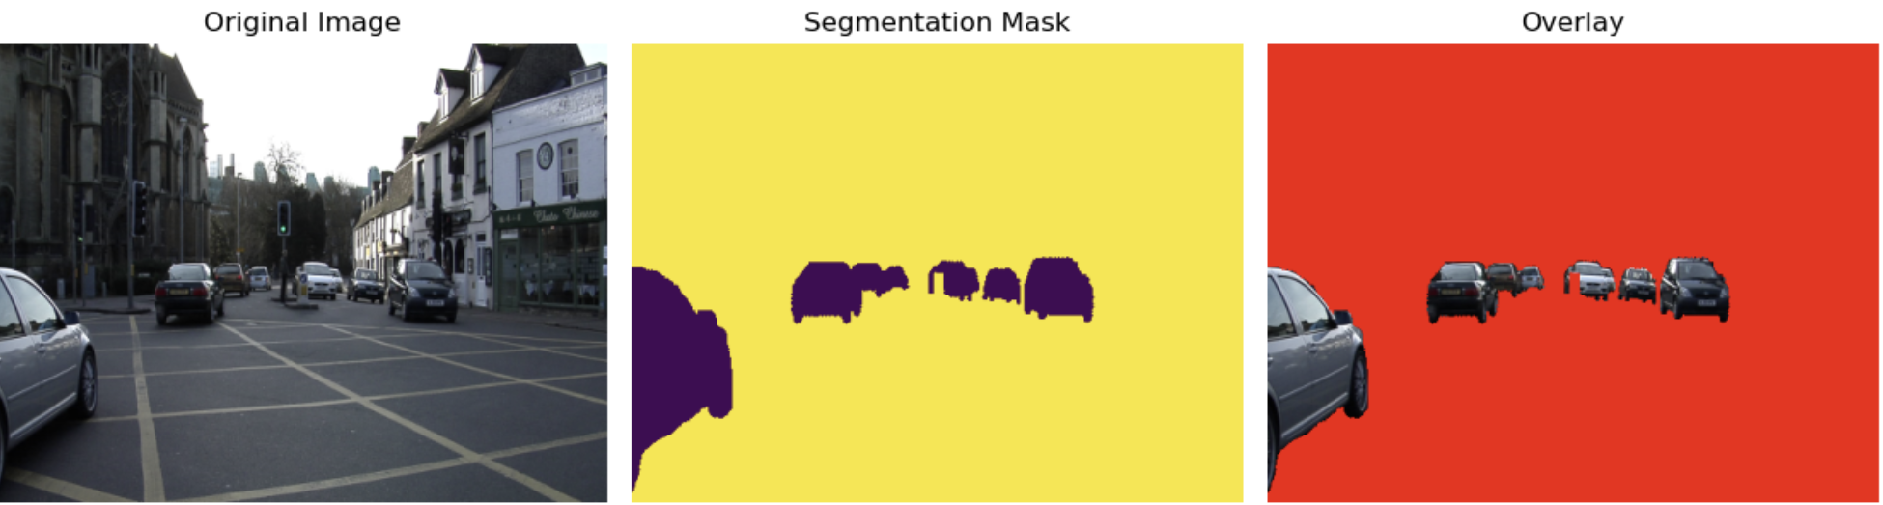
Dataset EDA
Class 5 - Vegetation, exist in 319 files
Class 6 - Traffic Sign, exist in 351 files
Class 7 - Fence, exist in 173 files
Class 8 - Vehicle, exist in 360 files
RCNN

Slide 11
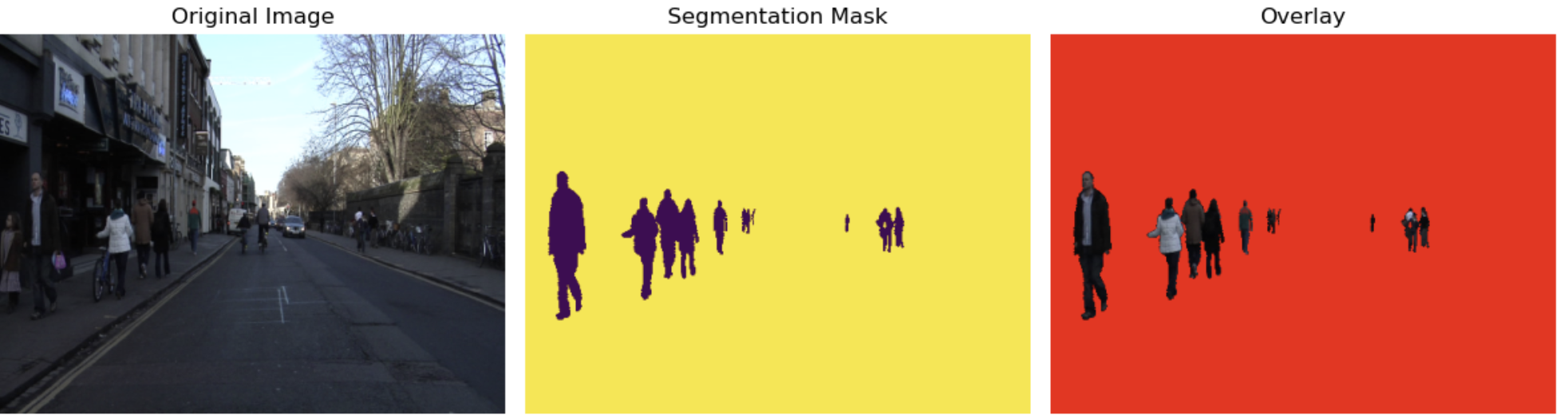
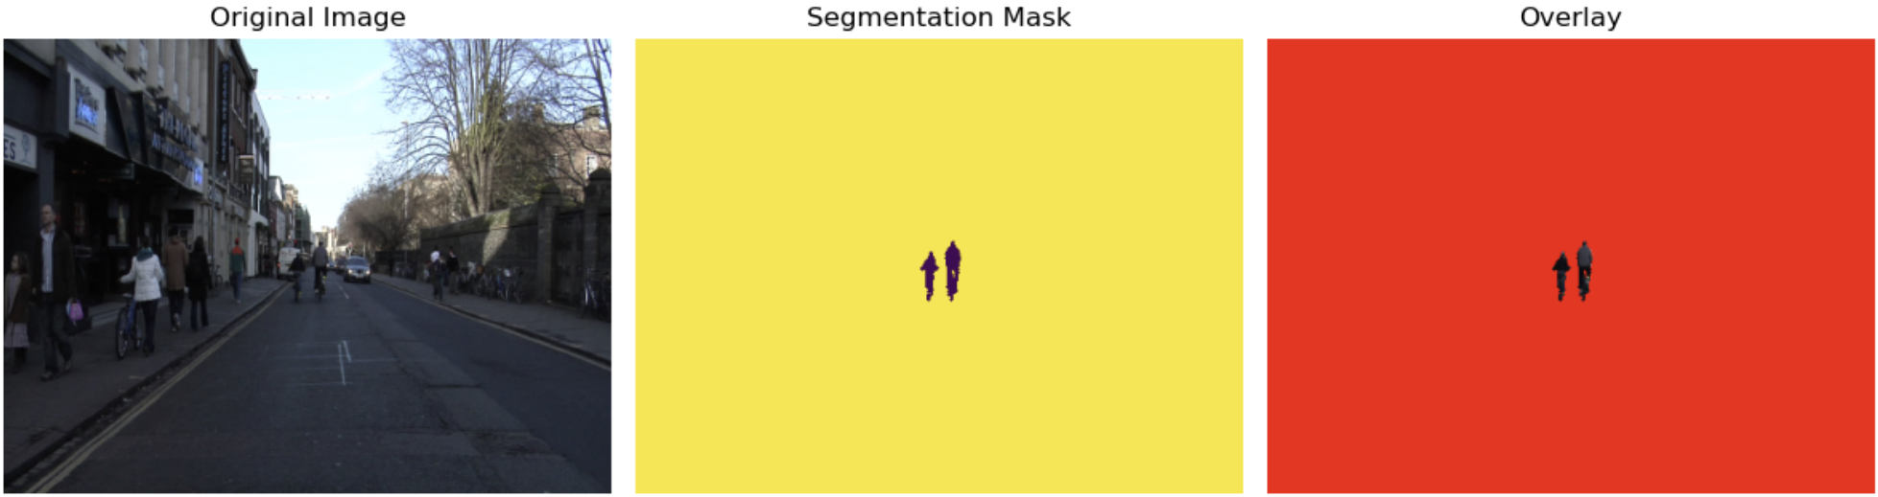
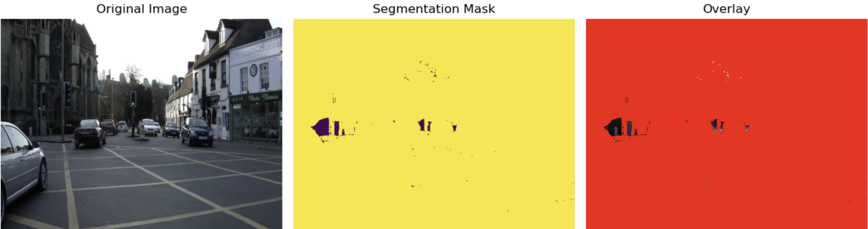
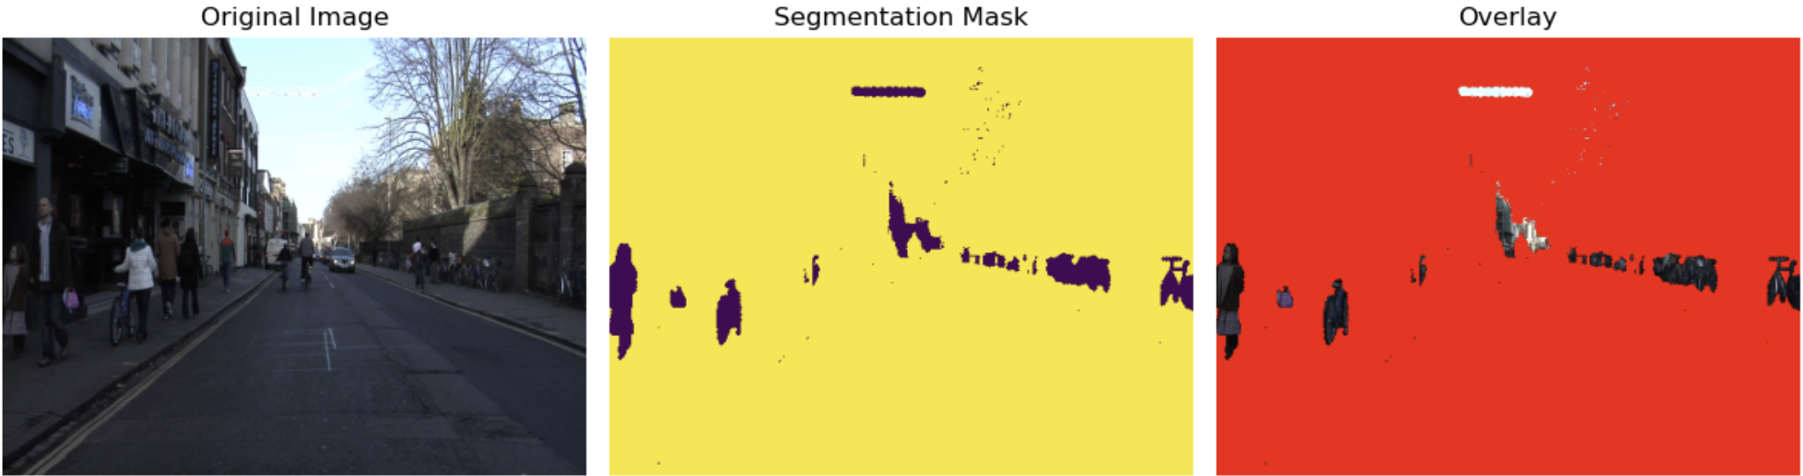
Dataset EDA
Class 9 - Person, exist in 317 files
Class 10 - Rider, exist in 201 files
Class 11 - Void, exist in 367 files
RCNN

Slide 12
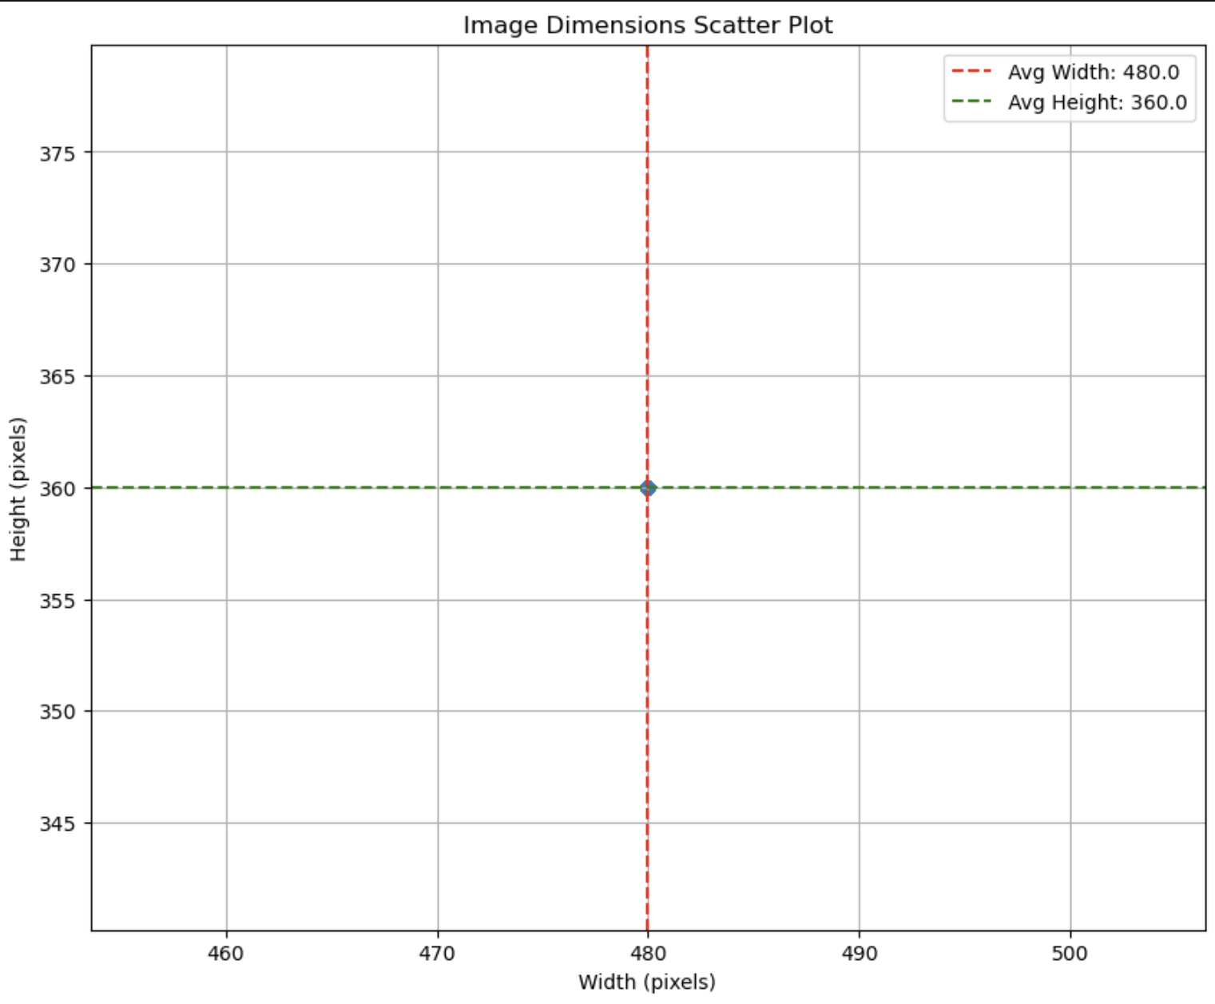
Dataset EDA
Image Resolution Distribution
All image files has same resolution:
Width: 480
Height: 360

Slide 13
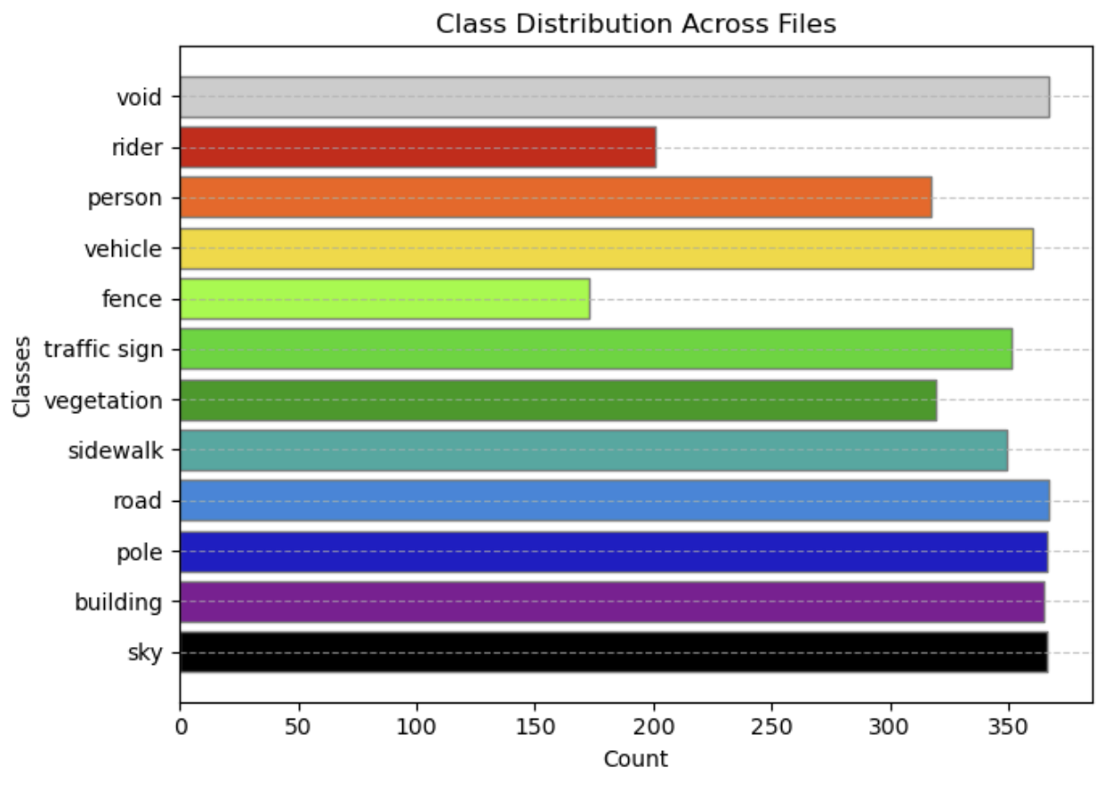
Dataset EDA
Class Distribution
Class | Label | Count
0 | sky | 366
1 | building | 365
2 | pole | 366
3 | road | 367
4 | sidewalk | 349
5 | vegetation | 319
6 | traffic sign | 351
7 | fence | 173
8 | vehicle | 360
9 | person | 317
10 | rider | 201
11 | void | 367
RCNN

Slide 14
Model development
FCN8s
Loss Function
Dice Loss
Cross Entropy Loss
Combined
U-Net
Loss Function
Dice Loss
Cross Entropy Loss
Combined
RCNN
Combined = 0.5 * Dice Loss + 0.5 * Cross Entropy Loss

Slide 15
Training protocol
Hyperparameters:
Learning Rate Scheduler
Data / Image Augmentation
Parameter | Value
Train Data | 367
Validation Data | 101
Optimizer | Adam
Learning Rate | 1e-3, with Scheduler
Loss Function | Dice Loss Cross Entropy Loss, Combined
Epoch | 60
Batch Size | 32
Other default params: https://docs.pytorch.org/docs/stable/generated/torch.optim.Adam.html
Parameter | Value
Type | ReduceLROnPlateau
Factor | 0.1
Patience | 10
Threshold | 0.01
Threshold Model | rel (Relative)
Cooldown | 2
Min Learning Rate | 1e-6
Other default params: https://docs.pytorch.org/docs/stable/generated/torch.optim.lr_scheduler.ReduceLROnPlateau.html
Parameter | Value
Resize | Size: 256x256
HorizontalFlip | P: 0.5
ColorJitter | Brightness: 0.2 Contrast: 0.2 Saturation: 0.2 Hue: 0.1 P: 0.5
Normalize | Mean: 0.485, 0.456, 0.406 Std: 0.229, 0.224, 0.225

Slide 16
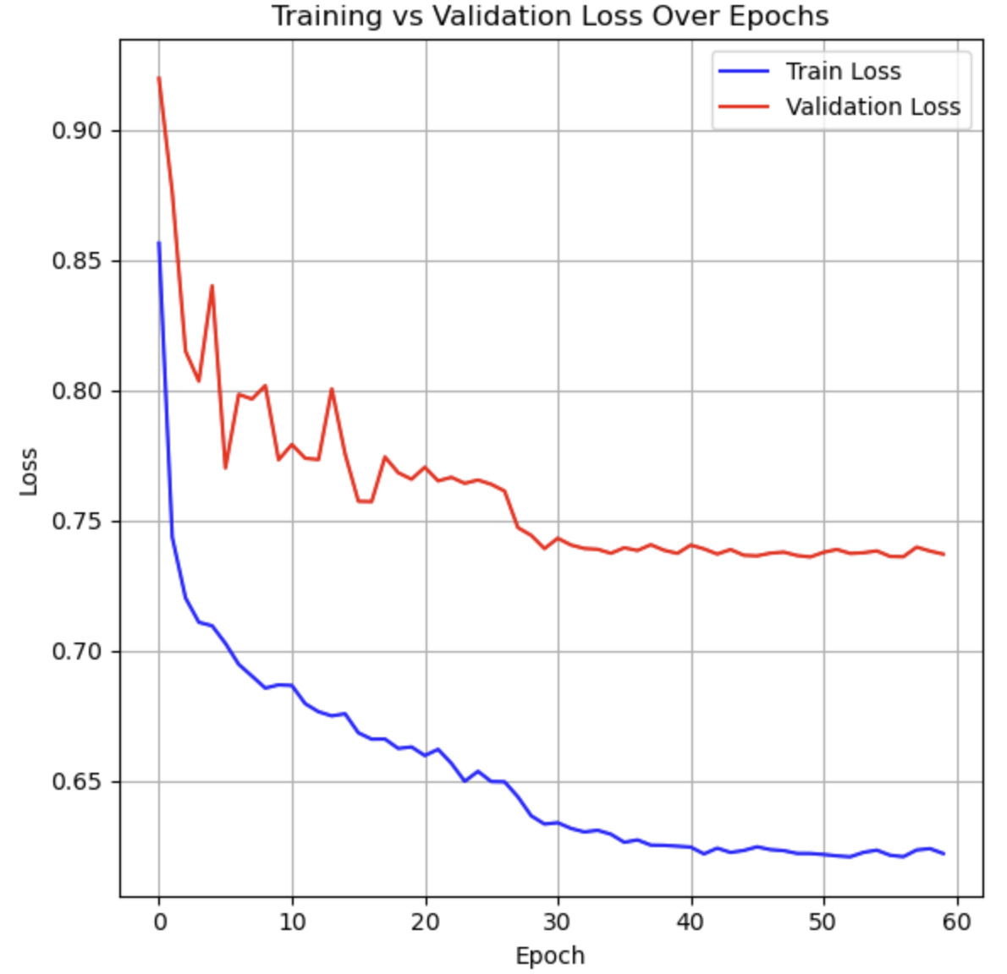
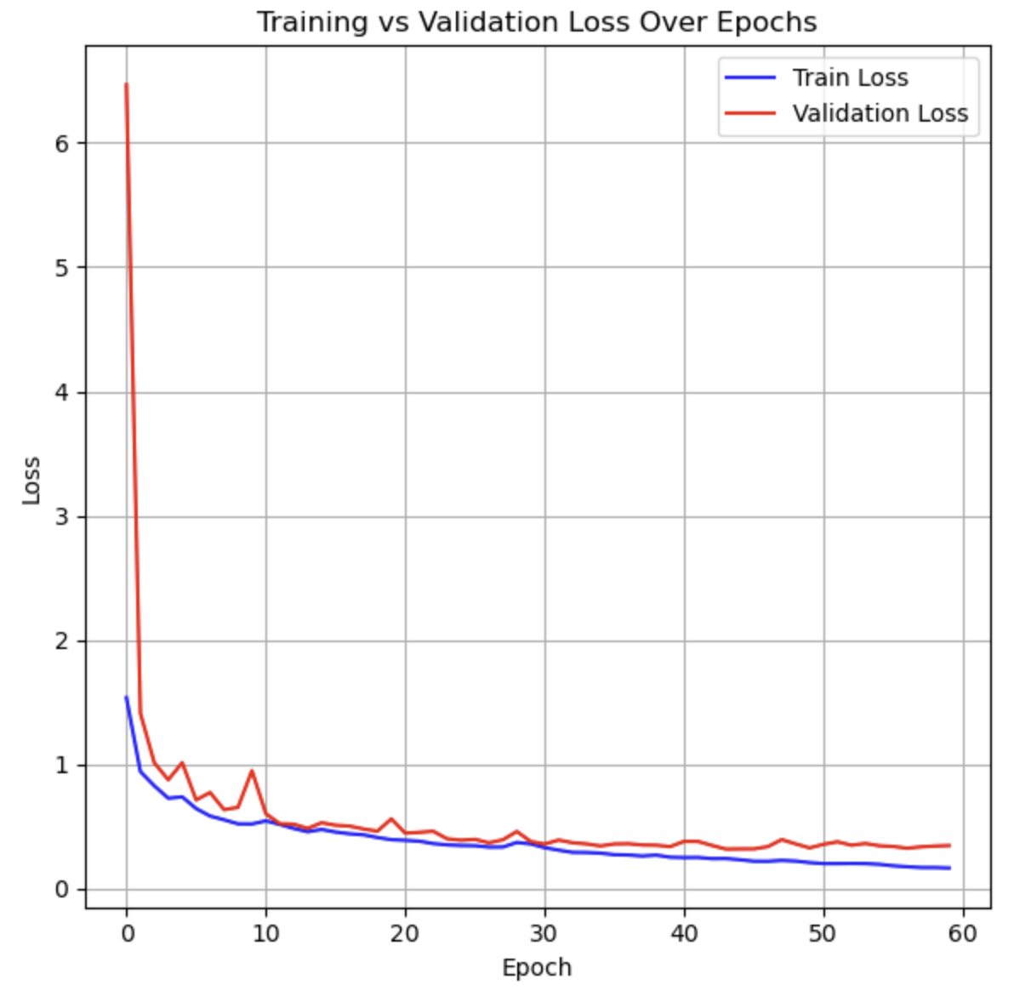
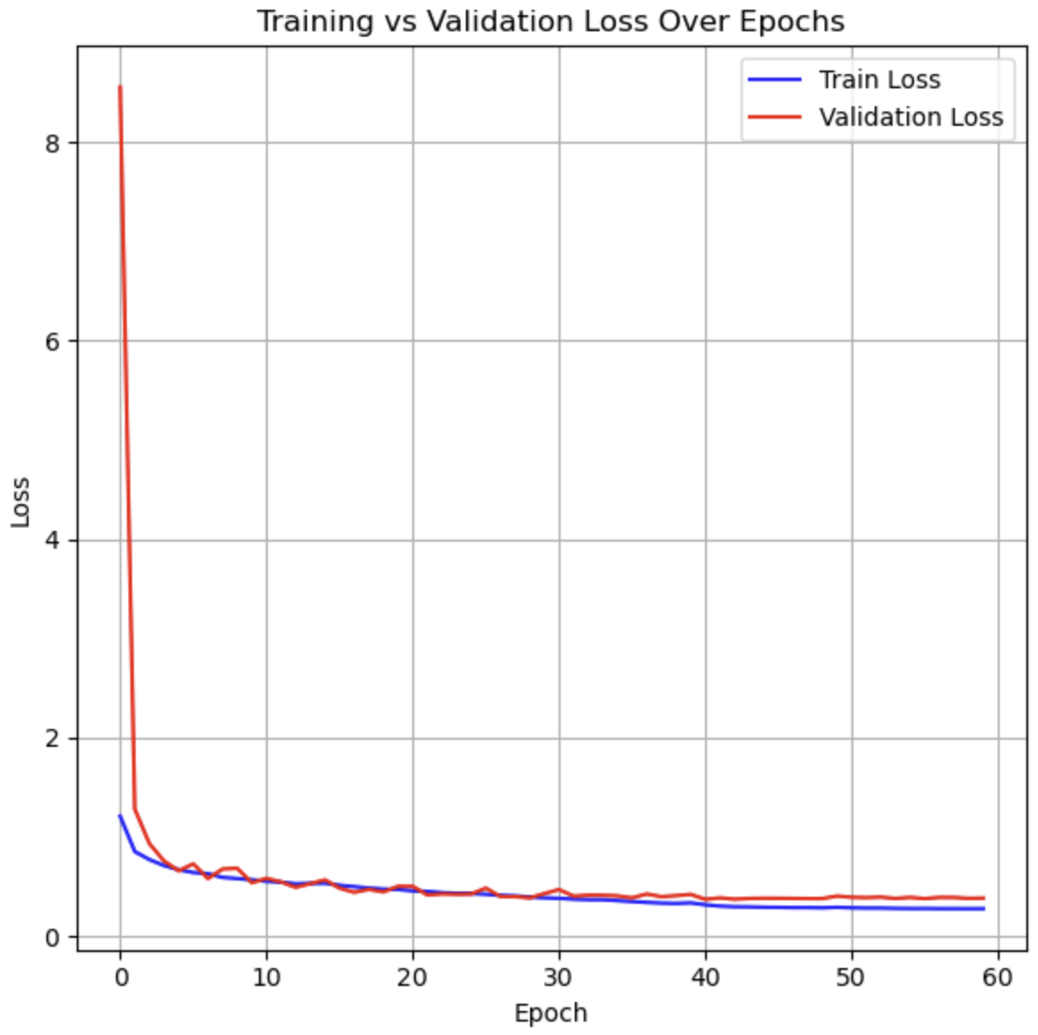
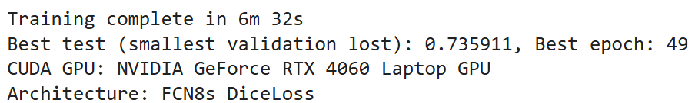
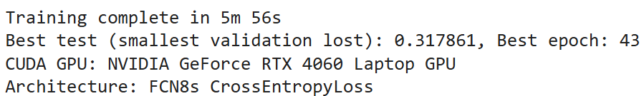
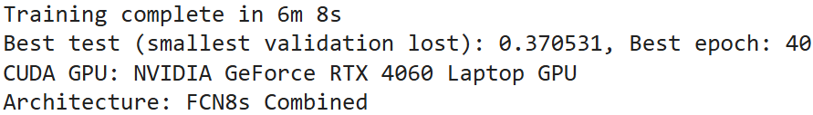
Evaluation metrics (FCN8s)
Dice Loss
Cross Entropy Loss
Dice Loss + Cross Entropy Loss
Best epoch is 49, 43, and 49. There is no indication of overfit yet at that epoch.
Training time is relatively fast around 6-7 minutes using GPU NVIDIA RTX 4060

Slide 17
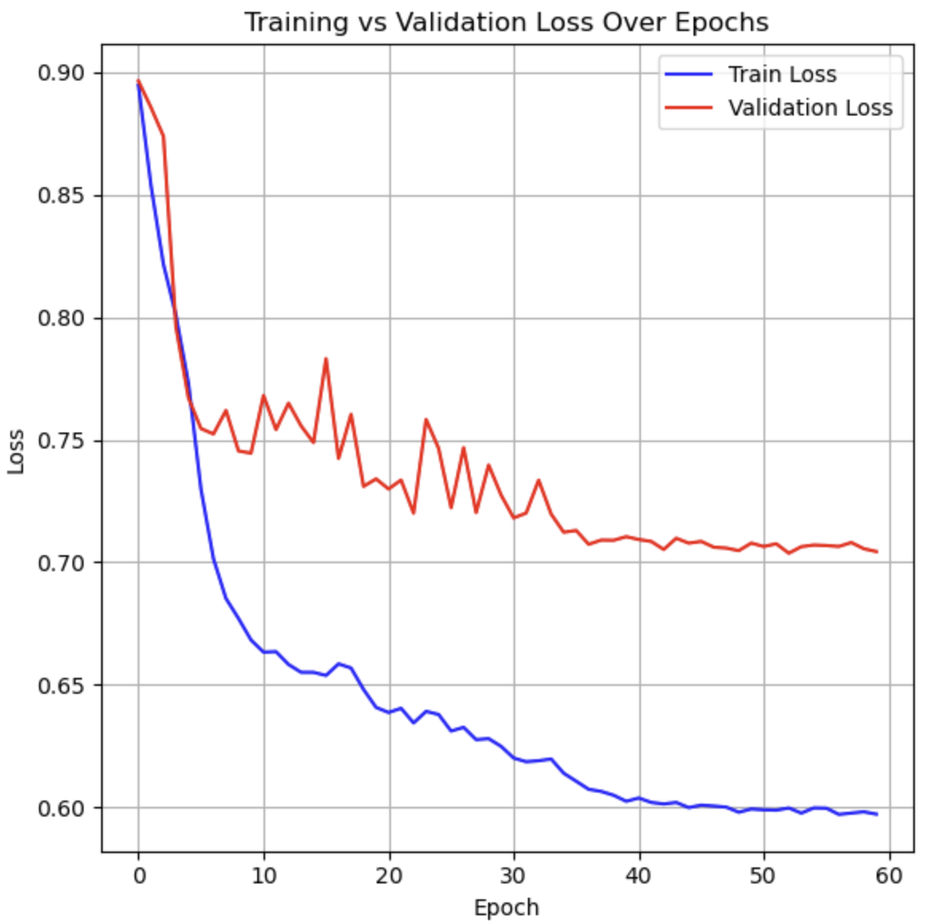
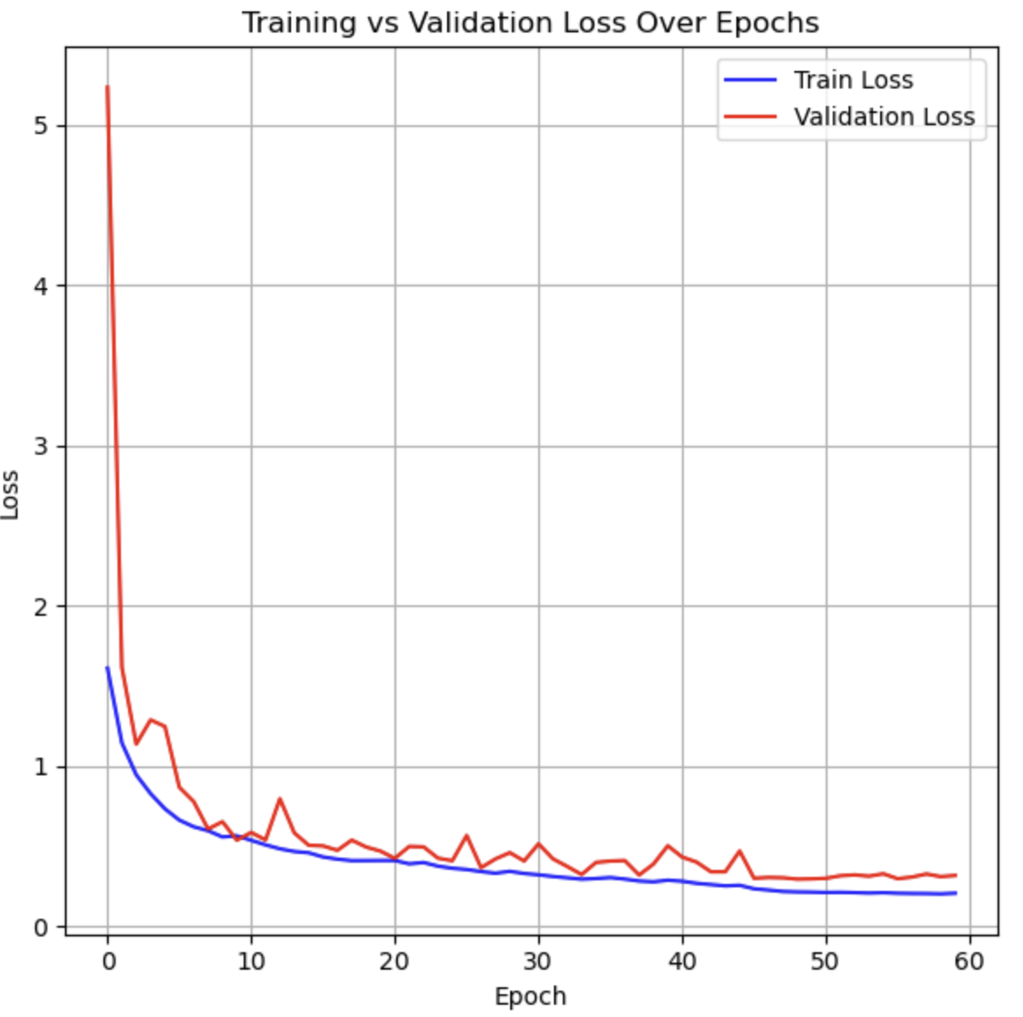
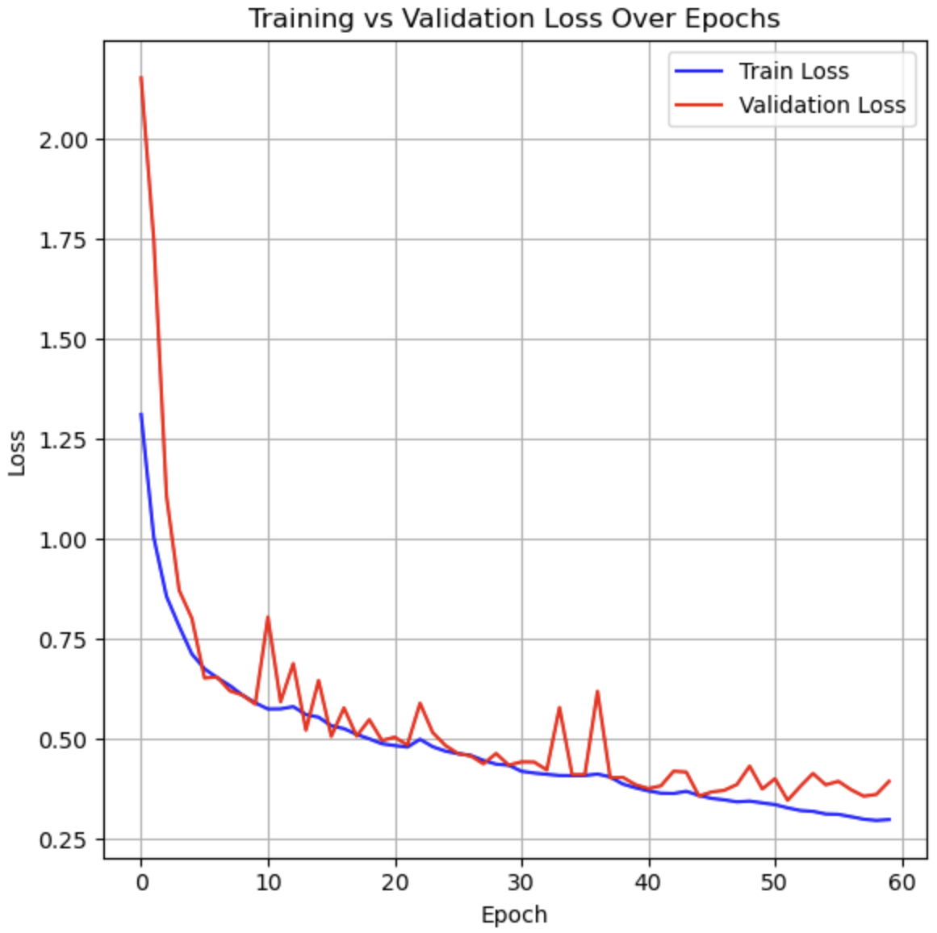
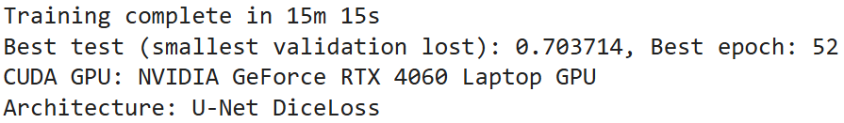
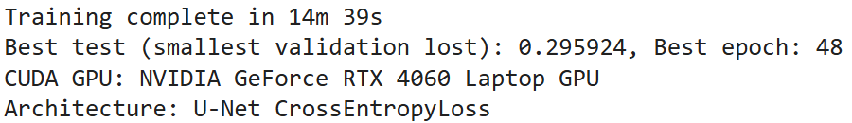
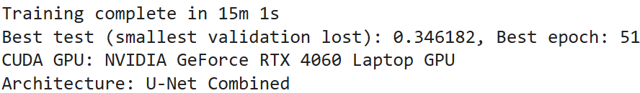
Evaluation metrics (U-Net)
Dice Loss
Cross Entropy Loss
Dice Loss + Cross Entropy Loss
Best epoch is 52, 48, and 41. There is no indication of overfit yet at that epoch.
Training time is slower than FCN8s, around 14-15 minutes using GPU NVIDIA RTX 4060

Slide 18
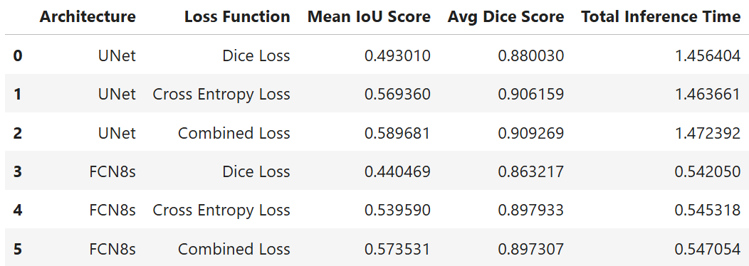

Validation
Test Dataset: 101 Files, GPU: RTX 4060 GPU, Batch Size: 32
Note: Total_Time is total time required to inference all 101 test dataset files
U-Net has a better accuracy compare to FCN8s. However the Inference time of FCN8s is faster than U-Net.
The model trained with the combined loss function achieves higher accuracy compared to models trained with other loss functions.

Slide 19
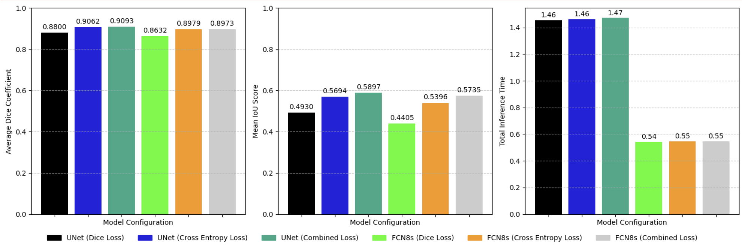
Validation
Average Dice Coefficient
Mean IoU Score
Total Inference Time

Slide 20
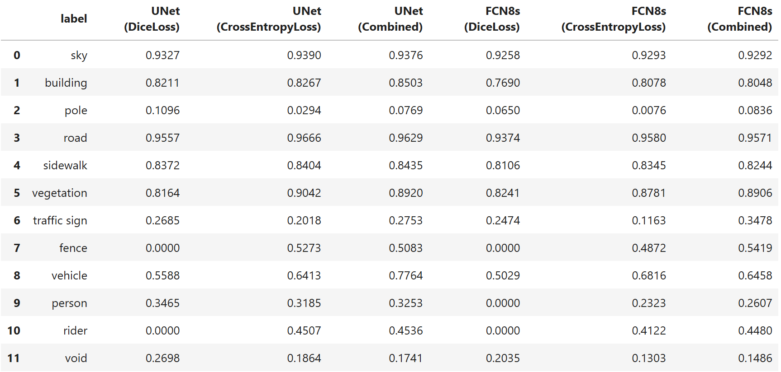

Validation
Mean IoU Score Per Class
Each model has its own strengths and weaknesses in detecting different classes.

Slide 21
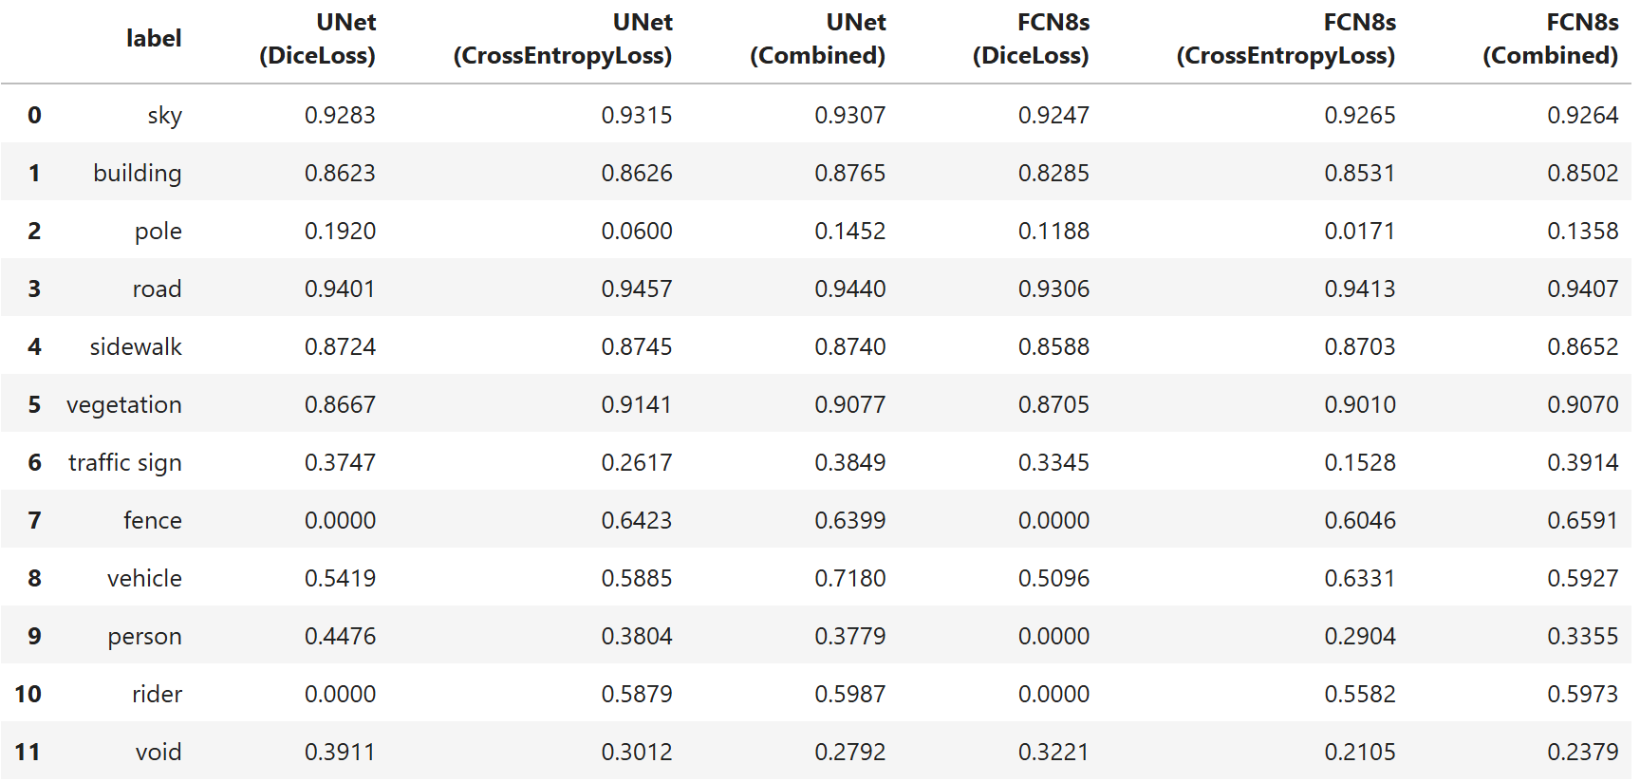
Validation
Mean Dice Score Per Class
Each model has its own strengths and weaknesses in detecting different classes.

Slide 22
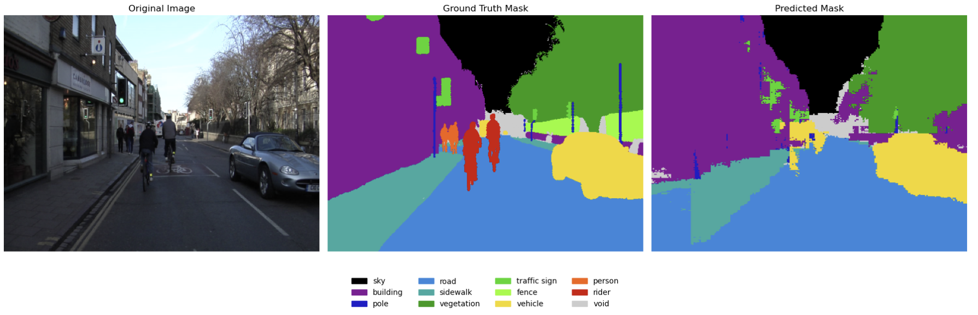
Inference FCN8s
Loss Function: Dice Loss
Big object such as Building, Roadwalk, Vegetation, Car still can be segmentized.
Medium and small object such as Rider, Person, Pole are not detected by the model

Slide 23
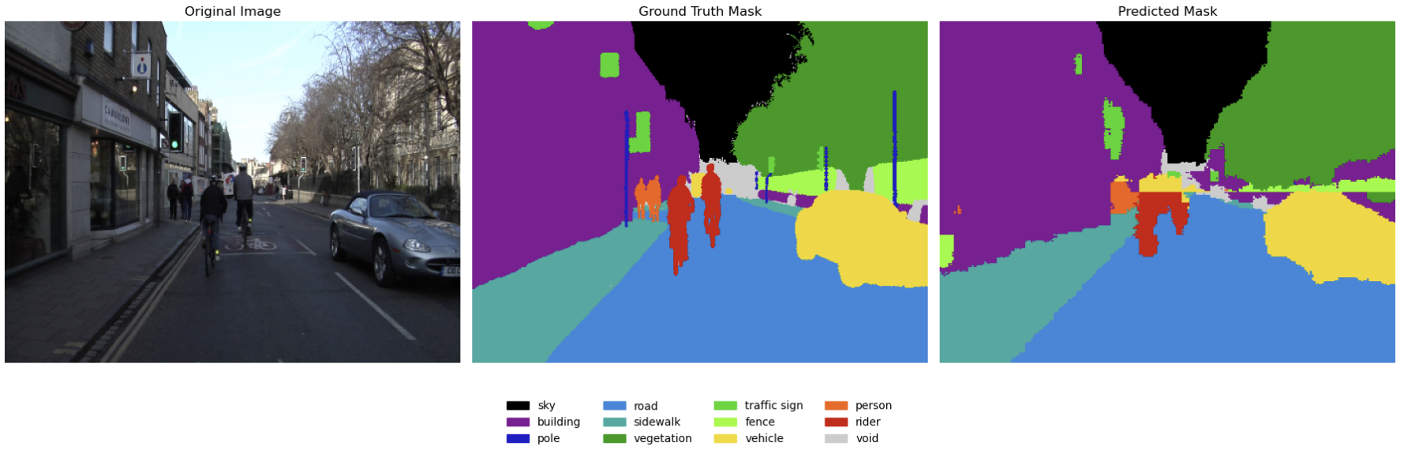
Inference FCN8s
Loss Function: Cross Entropy Loss
Big and medium object such as Building, Roadwalk, Vegetation, Car, Rider, Person can be segmentized.
Some false classification to object that are similar.
Notes:
Tambahkan summary kesimpulan singkat / hasil analisis (1-2 point)

Slide 24
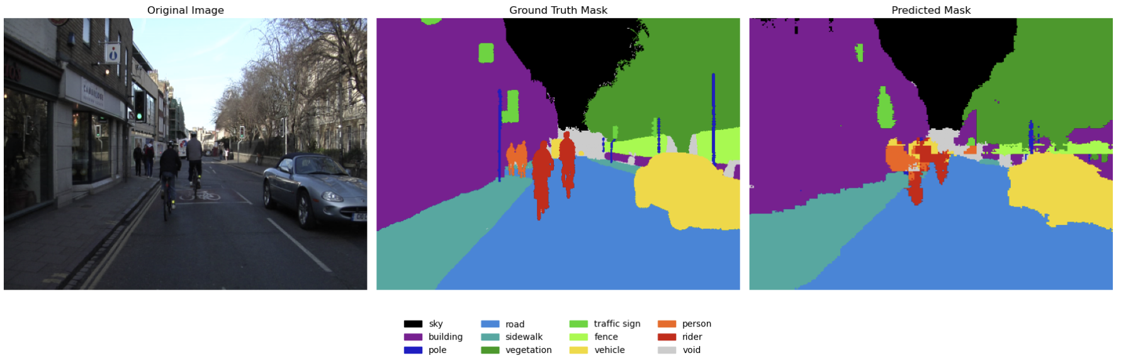
Inference FCN8s
Loss Function: Combined
Almost identical result with Model trained with Cross Entropy Loss Function. Model is capable to detect most of classes, except small one such as Pole and Traffic Sign

Slide 25
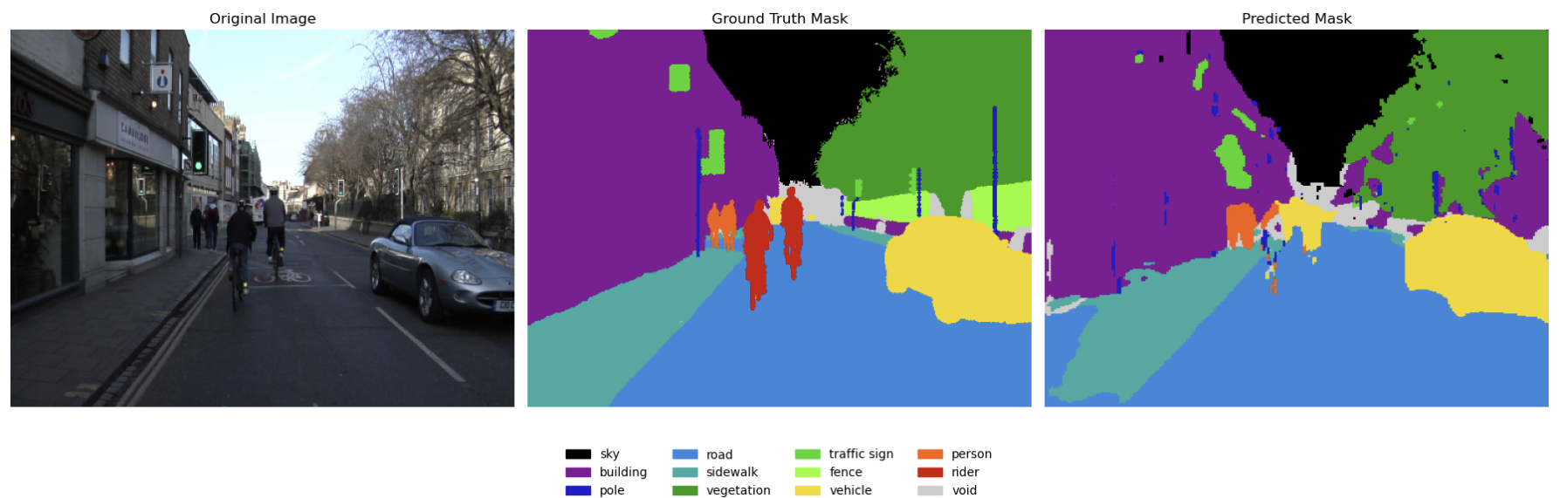
Inference U-Net
Loss Function: Dice Loss
The predicted mask appears to capture most major classes (e.g., sky, road, vehicles) similarly to the ground truth, but discrepancies may exist in finer details (e.g., poles, traffic signs) or ambiguous regions (e.g., edges of sidewalks, vegetation)

Slide 26
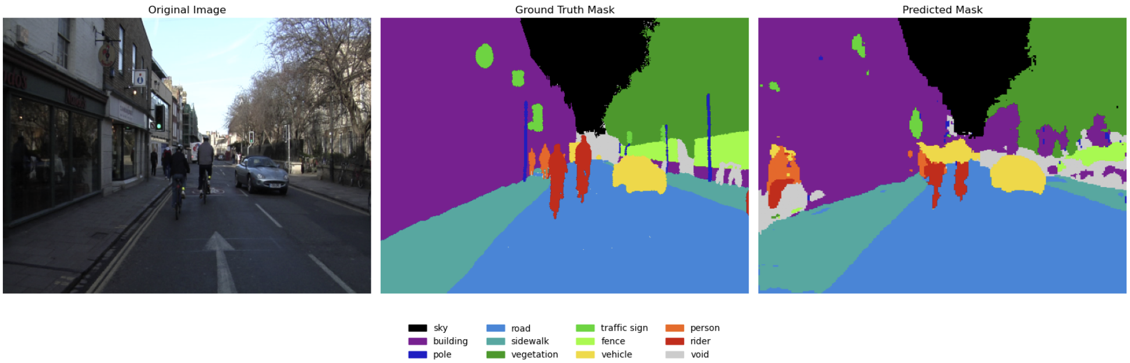
Inference U-Net
Loss Function: Cross Entropy Loss
Pixel accuracy is better then U-Net trained with Dice Loss but small imbalance model (ex: Traffic Sign and Pole) is detection is lesser than U-Net trained with Dice Loss

Slide 27
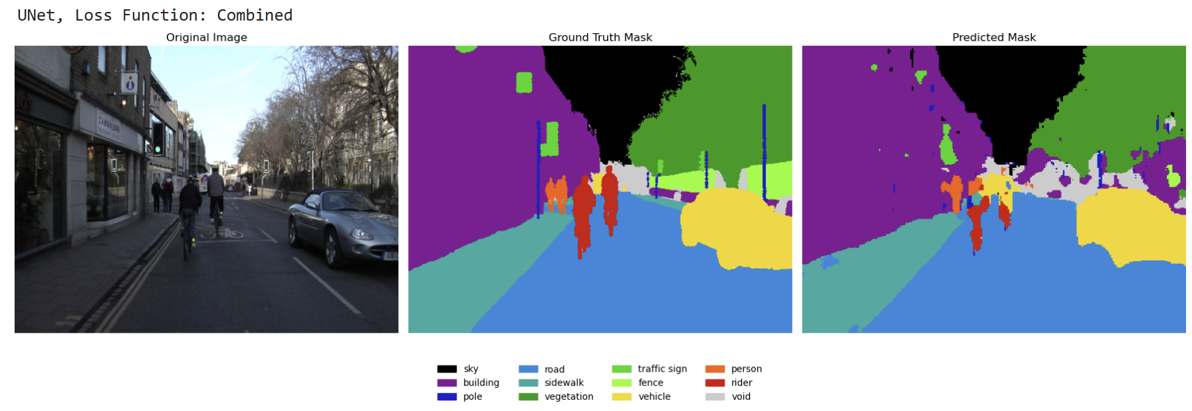
Inference U-Net
Loss Function: Combined
Pixel accuracy is better th
The combination of the Dice Loss and Cross Entropy Loss functions improves model performance. Detection of small objects (e.g., person, traffic sign, pole) is comparable to using Dice Loss alone, while pixel-level accuracy remains comparable to Cross Entropy Loss

Slide 28


Conclusion & Future improvement
Conclusion:
FCN8s and U-Net are both capable of performing object segmentation on the Cityscapes dataset
The choice of training loss function significantly impacts the accuracy of both FCN8s and U-Net. Best loss function for Cityscape semantic segmentation is Combination of Dice Loss and Cross Entropy Loss (50% of Dice Loss + 50% of Cross Entropy Loss)
FCN8s demonstrates faster training (2 times faster) and inference times (2,6 times faster) compared to U-Net, making it more suitable for applications requiring rapid processing
U-Net trained with Combined Loss Function has the best accuracy during inference test (Mean IoU SCore: 0.59 and Average Dice Score: 0.91)
Future Improvement
Improve accuracy of the model by using larger dataset (ex: complete Cityscape dataset)
Experiment with other architectures (U-Net + PreEncoders, YOLO, Detectron2, DeepLabv2)
Experiment with image augmentation, learning rate scheduler and other hyperparameters during training to improve the model accuracy

